Slide 1
LibQUAL+ Fall 2011
Jan Lewis, Associate Dean
Joyner Library
East Carolina University

Slide 2
LibQUAL+ Lite
2011 is the first year we administered Lite
LibQUAL+: 22 core, 5 local, 5 info lit, and 3 general satisfaction items, plus demographic
LibQUAL+ Lite: all respond to one linking item from each subscale plus 5 of remaining 19 core, 1 local, 2 info lit, 2 general satisfaction, plus demographic

Slide 3
1,516 responses
Undergraduate students:
Completed 1,211 surveys (79.88% of all surveys)
Graduate students:
Completed 296 surveys (19.53% of all surveys)
Faculty & staff:
Completed 9 surveys (0.59% of all surveys)
Nine percent response rate
Notes:
2009: 1,103 total - 672 Undergrad (71.7%), 348 Grad (22.7%), 76 faculty (7%) (1020 students)
2007: 249 total – 95 Undergrad (38%), 153 Grad (61%), 1 faculty (online classes)
2003: 236 total – 135 Undergrad (57%), 51 Grad (21.6%), 45 faculty (19%), 5 library staff (2%)

Slide 4
Survey Responses by User Group

Slide 5
How Often Do You Use Resources on Library Premises?
Notes:
More than 60% of UG’s say they “use resources” on library premises at least weekly, up from 52% in 2009. 86.62%: Joyner; 3.14% Music; 8.18% Online use of ECU Library resources; 0.74% Laupus; 1.32% Other.

Slide 6
How Often Do You Access Library Resources through a Library Web Page?

Slide 7
General Satisfaction Levels

Slide 8
What is Most Important to Undergraduate Students:
A comfortable and inviting location: 8.33
Employees who are consistently courteous: 8.26
Adequate hours of service: 8.23
Providing help when and where I need it: 8.19
A quiet space for individual activities: 8.14
Readiness to respond to users’ questions: 8.13
Notes:
UG: 0 IC, 3 LP, 3 AS (in 2009: UG: 3 IC, 1 LP, 1 AS)
Most important = highest Desired averages.

Slide 9
Affect of Service Scores: Undergraduate Students
Notes:
How did respondents interpret “availability of help when using electronic resources” and “providing help when and where I need it”? What explains the difference in scores? The difference is more exaggerated in the Graduate Student results. Different subsets answered each question. Grad student difference may also relate to whether student is DE.

Slide 10
Library as Place Scores: Undergraduate
Notes:
Pretty good separation between blue and green in most areas, meaning we clearly exceed minimum requirements in most areas. However, there is lots of room to improve on items 4 & 5 (space between green and red). There will be a slide that focuses on the largest gaps later. Note that I moved “Modern equipment” from IC to LP on these graphs.

Slide 11
Information Control Scores: Undergraduate
Notes:
We’re in good shape for exceeding minimum requirements – lots of space between blue and green. Largest gaps (bet red and green) are for “Easy-to-use access tools”, “library web site…” and journal collections

Slide 12
Undergraduate Superiority Gaps by Service Dimension 2007-2011
Notes:
2007 survey was of students in online courses, so we expected a small superiority gap for Library as Place. It is disappointing to see the slightly higher gap in 2011, after the CLC, TRC and STEPP renovations. Explanation? Crowded / tension with PTC? In 2009, Desired Means were slightly lower for 4 of 5 LP items, so that explains some of the difference. Perceived scores for all 5 LP items actually went up.

Slide 13
Largest Superiority Gaps: Undergraduate Students
Notes:
4 LP and 1 IC

Slide 14
What is Most Important to Graduate Students?
Making electronic resources accessible from my home or office: 8.47
Using the library for research: 8.39
Making information easily accessible for independent use: 8.36
Willingness to help users: 8.34
Modern equipment that lets me easily access needed information: 8.32
Notes:
Most important = Highest Desired averages
3 IC 1 LP 1 AS (in 2009 top 5 were IC). Modern equipment is IC, but really can be looked at as LP. 4 of these items received higher mean scores than any of the UG’s most desired items. Web site and hours of service were 8.31 and 8.30.

Slide 15
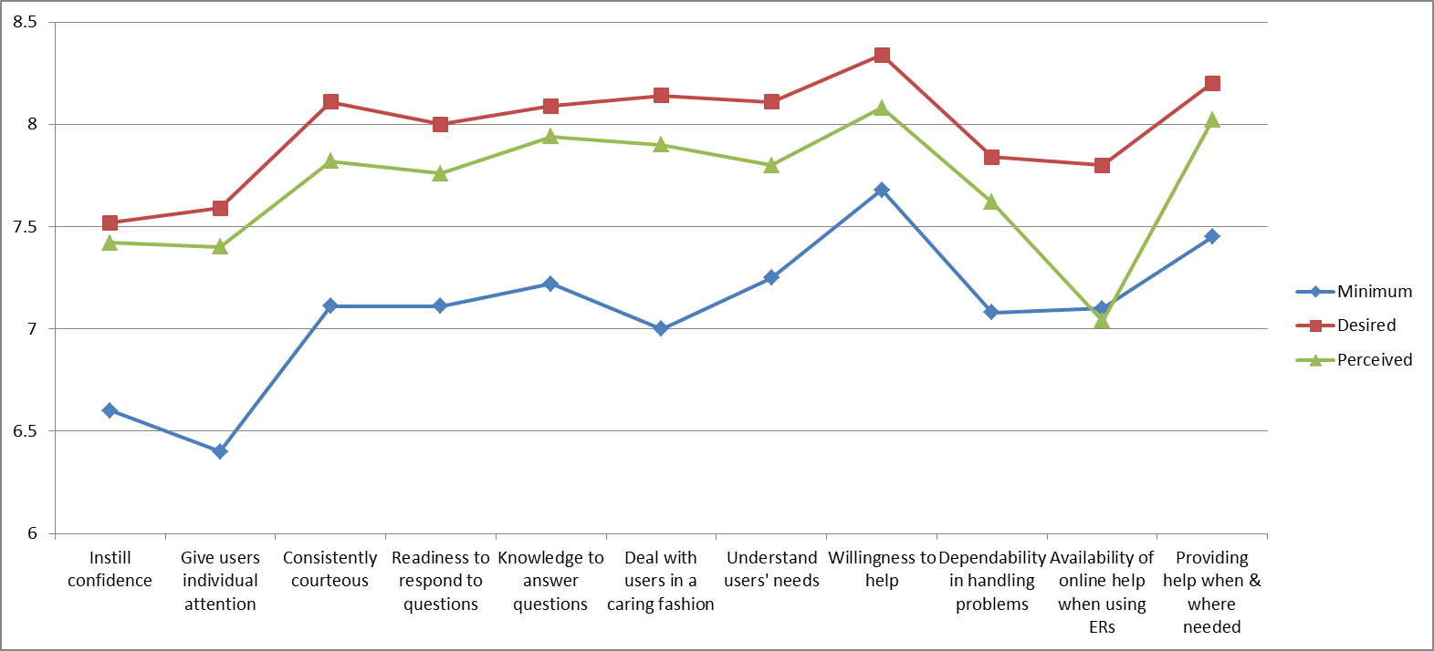
Service Scores: Graduate Students
Notes:
Perceived score for “availability of help when using electronic resources” is lower than the minimum requirement – only two items in the survey with this result. Lots of room for improvement here. How did respondents interpret this item and “providing help when and where I need it” that explains the difference in scores? . Different subsets answered each question. Grad student difference may also relate to whether student is DE.
Perceived score for “availability of help when using electronic resources” is lower than the minimum requirement – only two items in the survey with this result. Lots of room for improvement here. How did respondents interpret this item and “providing help when and where I need it” that explains the difference in scores? . Different subsets answered each question. Grad student difference may also relate to whether student is DE.

Slide 16
Library as Place Scores: Graduate
Notes:
Adequate hours of service – perceived is below minimum.

Slide 17
Information Control Scores: Graduate
Notes:
Libraries teaching me how to access/manage info is the only item where Perceived was greater than Desired on the entire survey.

Slide 18
Graduate Student Superiority Gaps by Service Dimension 2007-2011
Notes:
2007 superiority gap for Library as Place was expected to be small b/c we surveyed students in one or more online courses.

Slide 19
Largest Superiority Gaps: Graduate Students
Notes:
Hours also appeared on the UG chart. #3 IC and 3 LP.

Slide 20
Comparison of Superiority Gaps by User Group

Slide 21
Information Literacy Outcomes

Slide 22
Adequacy Gaps
2011:
2 adequacy gaps for graduate students
Hours
Online help using ERs
0 adequacy gaps for undergraduate students
0 overall
2009:
7 adequacy gaps for faculty
0 for graduate students
0 for undergraduate students
0 overall
Notes:
Both gaps are for Local Questions that we chose to include on the survey. We did a good job of selecting questions that are important to our students.

Slide 23
Adequacy Gaps
2011
2007
2 adequacy gaps for graduate students
Hours
Online help using ERs
0 adequacy gaps for undergraduate students
0 overall
6 adequacy gaps for graduate students
0 for undergraduate students
2 overall adequacy gaps (grad, undergrad & faculty)
Notes:
2007: 2 Affect of Service; 4 Information Control (grad); overall both are for IC: Easy-to-use access tools; print and/or electronic journals I require for my work.

Slide 24
Adequacy Gaps
2011
2003
2 adequacy gaps for graduate students
Hours
Online help using ERs
0 adequacy gaps for undergraduate students
0 overall
15 adequacy gaps for faculty
6 adequacy gaps for graduate students
0 for undergraduate students
1 overall adequacy gap
Notes:
2003: Faculty: 3 Access to Info, 7 Affect of Service, 5 Personal Control
2003: Grad: 4 Access to Info and 2 PC
2003: Overall gap was for Access to Info: print and/or electronic journal collections I require for my work.

Slide 25
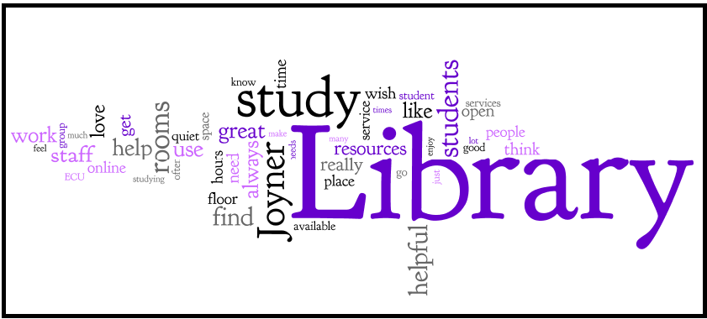
LibQUAL+ Comments

Slide 26
Summary
615 comments
521 Joyner, 11 Music, 70 Online
498 undergraduates, 115 graduate students
384 compliments
231 suggestions
126 complaints

Slide 27
Summary
368 Place
Study space, individual and group study rooms
Library hours
Overall environment (furniture, noise)
186 Service
Lots of compliments for staff, departments & services
117 Information Control
Electronic resources, web site, journals

