Slide 1
Staying Safe Online
Librarian to Librarian Networking Summit
February 2018

Slide 2
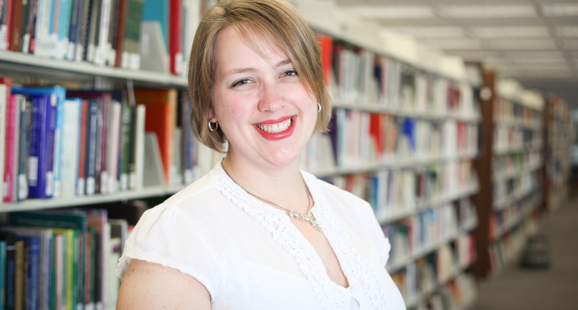
Amanda McLellan
Head of Applications and Digital Services
East Carolina University
Notes:
Introduce self

Slide 3
What do you want to know?

Slide 4
Digital in 2018: Global Overview
https://wearesocial.com/us/blog/2018/01/global-digital-report-2018

Slide 5

Educating Ourselves and Our Patrons
(P.S. The other half of the battle is sharing what we know)
Notes:
So why is this discussion important? Well, we interact with technology every day. And not everyone has the same access to information, or interest in keeping up with what can be an overwhelming topic. Increasingly, libraries are one of the only places many of our patrons can go to learn about things like security and privacy.

Slide 6
Digital Citizenship

Slide 7
Threats
Malware
  Viruses
  Worms
  Trojans
  Bots
  Spyware
Mal-People
  Hackers (Financial data, Healthcare data, personal data)
  Spoofers (including Catfishers)
  Scammers
  Identity Thieves
  Bullies and Trolls
  Predators
Notes:
Malware: any program designed to enter a computer and compromise its data or processes. Includes:
Viruses: self-replicating, come in attached to other files.
Worms: self-replication, can spread with no user assistance, enter through security holes in browsers, as attachments, or bad links.
Trojans: do something other than the intended function. Often used as keyloggers for passwords or other personal information.
Bot: receives instructions from 3rd party, not always malicious.
Spyware: collects personal information.

Slide 8

Prevention is the best medicine
Image: https://pixnio.com/objects/signs/wash-your-hands-sign
Notes:
The good news is that most threats can be prevented. You’re taking the first step here today – you’re learning about what’s out there and how to protect yourself. Practicing safe computing means taking a look before you leap or think before you click attitude. Or, if you prefer, we can apply “Trust but Verify”. We’re going to cover some of the ways you can protect yourself.

Slide 9
Prevention
Keep your computers up to date
Use an Anti-Virus program
Use a Pop-up blocker on your browser
Create and follow a backup plan
Create and use good passwords
  Password Manager
  2 Factor Authentication
Resources:
  Best Paid Anti-Virus: http://www.techradar.com/news/the-best-antivirus-software-of-2017
  Best Free Anti-Virus: http://www.techradar.com/news/the-best-free-antivirus

Slide 10
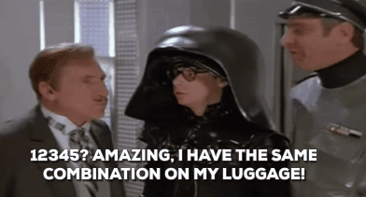
Strong Passwords
Unique to each site
Combination of Uppercase, lowercase, numbers and special characters
Notes:
Passwords are imperfect. The easier they are for us to remember, the easier they are to hack. However, for the time being, they are a big part of our world. So you need to learn to use good passwords!
Avoid dictionary words or identifying personal information.
Use mixed character sets.
Different passwords for different places
Consider using a password manager, such as LastPass, for an added layer of security.

Slide 11
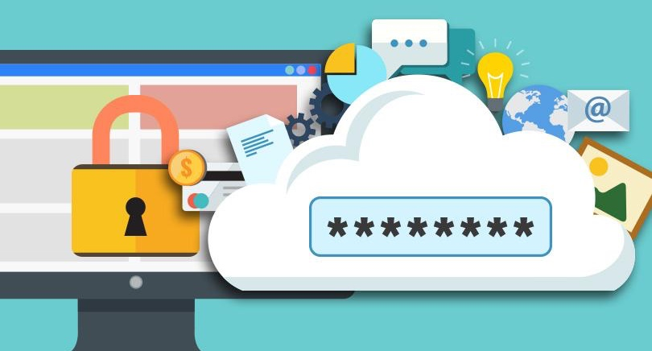
Utilize a Password Manager
Read more: http://thewirecutter.com/reviews/best-password-managers/ and http://www.pcmag.com/article2/0,2817,2407168,00.asp
Notes:
I have a couple of links here for reviews of password managers. There are many options out there, but they way they work is that you can store all of your passwords in an encrypted database, so that you only have to remember a singular master password. I personally use LastPass, which has a mobile application and browser plugins, but there are many other options available. Most password managers will also generate good secure passwords for you.

Slide 12
Two Factor authentication
Something you know + something you have
Notes:
How many people have heard of two-factor authentication?
The way it works is once it is enabled on say your email, when you enter your password, you will also need to provide a code. The code could be texted to you, or generated by an app like authy or the google code generator. Two factor authentication makes it very difficult to gain access to your private information unless someone also has your phone.

Slide 13
“Because our digital identities are so interconnected, providing access to a single account can often give hackers access to others.”
Peter Fernandez

Slide 14
Social Engineering Attacks
Image from: https://www.webroot.com/blog/2017/03/21/common-social-engineering-attacks/
Notes:
False friend requests, phone scams, craigslist, dating, etc. Be suspicious – don’t click links that seem off or too good to be true. Also – don’t be ashamed if you are tricked – remember it happened to former CIA director John Brennan.
A very common attack on Facebook and similar social media networks is to get a friend request from someone who is already your friend. The second request is from someone who is NOT your friend, but has taken their photo and is going through their friends list and adding each one. The next thing they usually do is private message the friends, saying they need help, please send money.
When you get a request like this, a) do not friend the second profile b) check to make sure your friend knows and report the fraudulent page and, most effectively, c) go to your privacy settings and make it so only you can see your friends list. This means that even if a malperson gets access to your page through spoofing or other means, they won’t know who your friends are, effectively ending their scam.

Slide 15
Recognizing phished and spoofed sites
A quiz for your students! https://www.opendns.com/phishing-quiz/
Notes:
You have probably seen warnings from IT not to believe emails telling you that you need to change your password. Spoofers are getting really good at sending emails that seem real. One trick is to look closely at the email address of the sender, and ensure it doesn’t have anything odd or misspelled.
Websites can also be spoofed. The URL of this website is NOT www.facebook.com – and if you were to put your username and password in here, the
The FBI estimates that between October 2013 and August 2015, email spoofing cost American businesses over $1.2 Billion

Slide 16
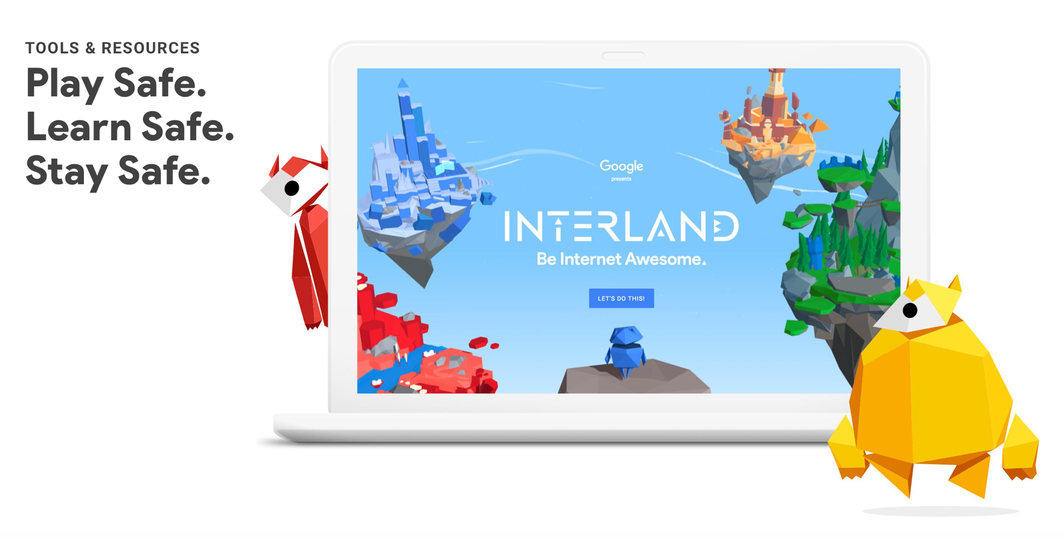
Be Internet Awesome
Notes:
https://beinternetawesome.withgoogle.com

Slide 17
Faux Paw

Slide 18
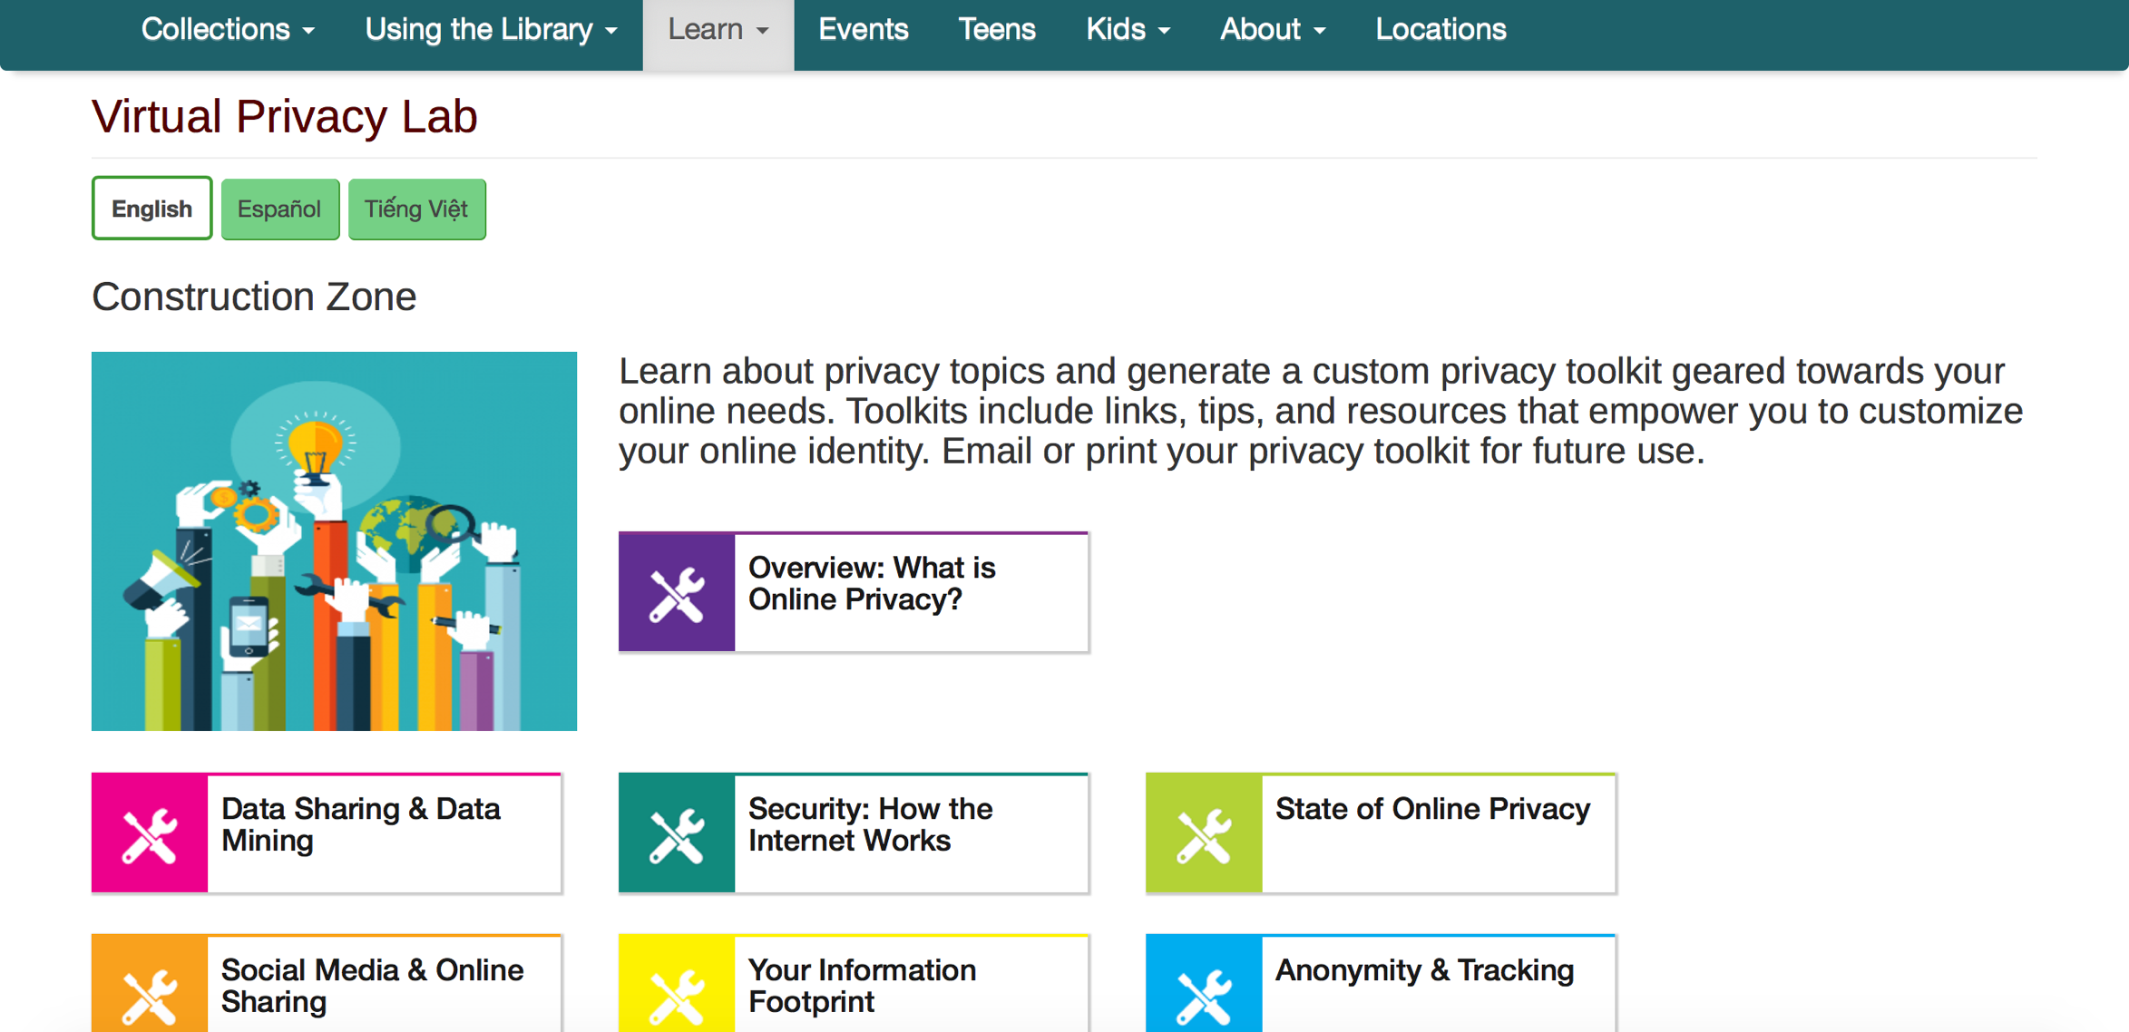
San Jose Public Library – Virtual Privacy Lab

Slide 19
Make (and follow) Family Rules for the Internet
Follow your family's rules about when and where to use the Internet.
Be polite, kind, and respectful.
Understand a website's rules, and know how to flag other users for misbehavior.
Recognize "red flags," including someone asking you personal questions such as your name and address.
Never share your name, your school's name, your age, your phone number, or your email or home address with strangers.
Never send pictures to strangers.
Keep passwords private (except from parents).
Never open a message from a stranger; it may contain a virus that can harm a computer.
Immediately tell an adult if something mean or creepy happens.

Slide 20
Other resources?

Slide 21
Questions & Discussion

Slide 22
Scenarios
A student clicks on a malicious link from an email, realizes their mistake, and comes to you for help. What do you do?
There has been an increase of cyberbullying events at your school. What are some steps you can take?
Who are some of your community partners/resources for dealing with security and privacy issues?
How might you incorporate Privacy and/or security education or activities into existing programming?

Slide 23
Further Reading - websites
Dredge, Stuart. “How Do I Keep My Children Safe Online? What the Security Experts Tell Their Kids.” The Guardian, Guardian News and Media, 11 Aug. 2014, www.theguardian.com/technology/2014/aug/11/how-to-keep-kids-safe-online-children-advice.
Hoffman, Chris. “Basic Computer Security: How to Protect Yourself from Viruses, Hackers, and Thieves.” How-To Geek, 4 Apr. 2017, www.howtogeek.com/173478/10-important-computer-security-practices-you-should-follow/.
Kiser, Matt. “The Normal Person's Guide to Internet Security.” GitHub, 30 Mar. 2017, http://github.com/mkiser/WTFJHT/blob/master/guide/internet-security.md.
"Library Privacy Checklist for Students in K-12 Schools", American Library Association, February 6, 2017. http://www.ala.org/advocacy/privacy/checklists/students
"Library Privacy Guidelines for Students in K-12 Schools", American Library Association, May 5, 2016. http://www.ala.org/advocacy/privacy/guidelines/students
Pinola, Melanie. “Top 10 Tech Security Basics Every Person Should Follow.” Lifehacker, Lifehacker.com, 26 Mar. 2016, lifehacker.com/top-10-tech-security-basics-every-person-should-follow-1767148925.

Slide 24
Further Reading - Articles
Breeding, Marshall. "High Security and Flexible Privacy for Library Services." Computers in Libraries, vol. 36, no. 5, June 2016, pp. 12-15. EBSCOhost.
Fortier, Alexandre and Jacquelyn Burkell. "Hidden Online Surveillance: What Librarians Should Know to Protect Their Own Privacy and That of Their Patrons." Information Technology & Libraries, vol. 34, no. 3, Sept. 2015, pp. 59-72. EBSCOhost.
Fernandez, Peter. "Through the Looking Glass: Helping Patrons Manage Passwords and Protect Their Digital Identities." Library Hi Tech News, vol. 33, no. 9, Oct. 2016, pp. 1-5. EBSCOhost, doi:10.1108/LHTN-09-2016-0041.
Gressel, Michael1. "Are Libraries Doing Enough to Safeguard Their Patrons’ Digital Privacy?." Serials Librarian, vol. 67, no. 2, Sept. 2014, pp. 137-142. EBSCOhost, doi:10.1080/0361526X.2014.939324.
Macrina, Alison. "Protecting Patron Privacy." Library Journal, vol. 141, no. 12, 7/1/2016, pp. 38-39. EBSCOhost.
Massis, Bruce. "The Internet of Things and Its Impact on the Library." New Library World, vol. 117, no. 3/4, Mar. 2016, pp. 289-292. EBSCOhost, doi:10.1108/NLW-12-2015-0093.
Nichols Hess, Amanda, et al. "Preserving Patron Privacy in the 21St Century Academic Library." Journal of Academic Librarianship, vol. 41, no. 1, Jan. 2015, pp. 105-114. EBSCOhost, doi:10.1016/j.acalib.2014.10.010.
West, Jessamyn. "Cybersecurity as an Extension of Privacy in Libraries." Computers in Libraries, vol. 36, no. 5, June 2016, pp. 24-25. EBSCOhost.

