Slide 1
Total Grant Makeover
February 21, 2015

Slide 2
Total Grant Makeover: Insider Tips for Creating Proposals that Funders Can't Refuse
Michele Oros – Beaufort County Schools Grantwriter
Cal Shepard – State Librarian

Slide 3
Top 10 Mistakes in Grant Applications

Slide 4
# 1
Project doesn’t fit grant category
Notes:
Reviewers are faced with a big pile of reviews to read – they LOVE if a grant doesn’t fit the category because they can STOP reading right there. It doesn’t matter how good the application is – it will be rejected. Example – asking for funds to renovate space when that isn’t allowed.

Slide 5
Eligible Applicants
501 (c)(3) – Non-Profit organization
(Public school districts are NOT classified as
501(c)(3) organizations but a PTA/PTO, Booster
Club, or Education Foundation may be)
LEA –Public school district
Independent School District-(How LEAs are classified
on question #9, Federal SF-424)
IHE-College or university
Possible demographic or geographic restrictions (rural/urban, poverty level, target population)

Slide 6
#2
Poorly defined project
Notes:
It is essential to have a clear project mission statement and understandable outcomes. Reviewers should not have to re-read sentences to parse out what the meaning is. If the project can’t be defined in simple terms then reviewers get suspicious. They DO see applications that are all “smoke and mirrors” where the writers are throwing around acronyms or other arcane terms. Sometimes they do this to a) prove their expertise or to b) cow reviewers into approving the application because they don’t think they are expert enough to understand the project. So sometimes the project is poorly defined ON PURPOSE!
Target audience should be defined – NOT “general public.”

Slide 7
In general, the purpose of a grant is to enhance, expand or initiate a project or activity to address a need or problem, using strategies that have been successfully employed in similar situations, to achieve positive, measurable results.

Slide 8
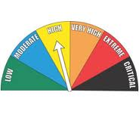
Levels of Risk
Low Risk: Enhance existing program
Moderate Risk: Expand existing program
High Risk: Initiate new program

Slide 9
CAUTION!
Before proceeding with any grantseeking efforts, discuss your idea with your principal or supervisor. Your school district or library may have administrative procedures and policies that must be followed regarding grants. Be especially wary of grants that require matching funds or obligate you, your school, or your library to ANYTHING, whether monetary or non-monetary, which you may be unable or unwilling to fulfill.
Also be aware that your school district or library is the recipient of any grants awarded, not the person who wrote the proposal. Materials and/or equipment purchased with grant funds are owned by the organization for which an applicant works and not by the grant writer.

Slide 10
#3
Application does not define a project
Notes:
Application does not define a project (e.g. just give me “stuff” grant)
We get a lot of “stuff” grants – project consists of adding computers or other equipment. This is NOT a project!
Projects have a beginning, middle and END.

Slide 11
A school or library is generally considered responsible for providing whatever is currently defined as “standard operating equipment” to deliver basic, mandated services. In the 21st century, this can include computing devices, broadband connectivity, e-readers, digital textbooks, and access to online learning resources.
It’s OK to write a grant proposal to purchase “stuff” as long as the “stuff” must be purchased in order to implement a project that responds to unmet needs or expands services beyond the basics.
Funds to purchase standard supplies and materials for regular classroom or library usage should be obtained through allocation, direct solicitation or fund raising.

Slide 12
#4
No evidence of need
Notes:
A TOP 2 fault!!!! No evidence of need (no numbers cited, no survey, no observation cited)
#1 - We get excited about our great ideas and are eager to jump in and start talking about the great project we want to do. Of COURSE it is needed! Everybody knows that. So it is VERY easy to just skip over proving a need. I have seen TOO many grants that jump over need and go right to describing their project. Even if it is a nationwide need and the whole world knows it – you still have to PROVE the need in your situation.
#2 – Many will include numbers that still don’t prove need. Do not simply say “We don’t have enough widgets” or “We have 100 widgets and that is not enough, the school down the road has 200 widgets.” This does not prove that YOUR school NEEDS any widgets at ALL!
Evidence of need does NOT have to be a scientific study! It can be as simple as counting the # of students at the same time every day for a week. Or taking a short in person survey – ask students 3 questions in short interviews.
Also - do your homework! Know what others have done who have gone before you. If you don’t cite this reviewers will question how well prepared you are positioned to carry out the project.

Slide 13
Profile and Needs Assessment
Use authoritative data or research and cite your sources.
Avoid “truisms” that are not backed by data or research.
Quantify anything and everything you can.
Avoid using words like: many, few, several, some, most, all, large, small, little, big, numerous, extensive, majority, minority, periodically, regularly, better, worse, higher, lower.
Contextualize local data by comparing with LEA, county, regional, state, national, or global data.

Slide 14
General Needs Assessment Data
http://www.census.gov/
http://statelibrary.ncdcr.gov/ghl/resources/statistics.html
http://www.osbm.state.nc.us/ncosbm/facts_and_figures/state_data_center.shtm
https://desncc.com/deshome
http://www.ncpublicschools.org

Slide 15
General Needs Assessment Data
http://www.ncwiseowl.org
http://www.nclive.org
http://www.guidestar.org
http://www.socialexplorer.com/
http://censusviewer.com/

Slide 16
Health and Nutrition Data Sources
http://www.usda.gov/wps/portal/usda/usdahome
http://www.usda.gov/wps/portal/usda/usdahome?navid=DATA_STATISTICS
http://kff.org/statedata/
http://www.ncagr.gov/stats/

Slide 17
Crime and Violence Data Sources
http://www.ncdoj.gov/
http://www.jrsa.org/dvsa-drc/index.html
http://crimereporting.ncdoj.gov/
https://www.ncdps.gov/Index2.cfm?a=000003,002476

Slide 18
Child Welfare Data Sources
http://datacenter.kidscount.org/data#NC/2/0
http://www.nccp.org/profiles/NC_profile_6.html
http://www.childtrendsdatabank.org/?q=node

Slide 19
#5
No partnerships (or faux partnerships)
Notes:
No partnerships or faux partnerships (this is closely related to need!)
Lack of partnerships is a contributing factor to “out of touch” projects. We get too many “I’ll design this and I’m sure they will love it!” projects where the planners haven’t even asked the target audience what they want or have done any kind of needs assessment FIRST.) this is the old “I have a hammer and EVERYHING looks like a nail” syndrome! It is too easy to stay in your comfort zone and look for ways to stay there! Example - DCR project that is NOT being used!
The broader the impact the better - and broad impact is easier to achieve with partners.
Faux partnerships are EASY to spot! You are not fooling the reviewers!

Slide 20
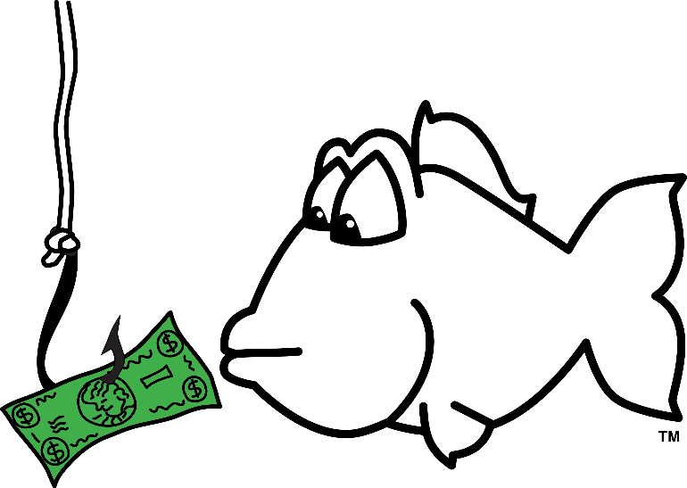
Pay it Forward…
The prospect of winning a grant can lure applicants into potentially dangerous alliances with unknown or questionable partners. Cultivate relationships with potential partners by joining boards of directors, volunteering at community events, and taking advantage of networking opportunities. Stay apprised of local news and keep tabs on non-profit organizations to assess their capacity, trustworthiness, reputation, and entanglements.

Slide 21
#6
No projection of what
constitutes success
Notes:
No projections of what will constitute success (e.g. 25% increase in circulation)
Projects are trying to DO something and what you do should be measurable! Numbers are absolutely necessary here. “Children will read more books” is not sufficient! So say how many books will be read! Here’s the truth – I would rather see a project have high ambitions (increase minutes read by 30%) and FAIL than to have no measurable success at all. Get your reviewers excited about your high ambitions!

Slide 22
S.M.A.R.T. Objectives
S.M.A.R.T. Objectives are
Specific
Measurable
Achievable
Relevant
Time-Bound
By a specified date, something will happen as a result of our project that we believe will make a measurable difference compared with data collected prior to implementation of the project.

Slide 23
#7
Evaluation does not measure anything
Notes:
Another Top #2 weakness in applications!
The plan for evaluation does not measure success – many times it just tells HOW they plan to evaluate! “We will count how many books the children check out for the month of March.” Hunh?
The evaluation should measure whether the project achieved the success predicted! (e.g. Students checked out 31% more books in March 2015 than they did in March 2014.)
If you only do ONE thing to improve your grant applications – pay attention to the evaluation! So MANY applicants do a lousy job here that your application will STAND OUT if you do a good job in this area! I am not kidding!!!

Slide 24
Measure What You Treasure
The evaluation plan should be integral to the project rather than a sidebar or afterthought.
Align the evaluation plan with the needs assessment, project activities, and S.M.A.R.T. objectives.
Describe the tools and methods that will be used to measure and document progress.
Seek both formative and summative data to enable mid-course adjustments if needed.
Monitor the evaluation process to ensure that data are collected and analyzed as outlined in evaluation plan.

Slide 25
#8
Budget and narrative do not agree
Notes:
Budget and narrative don’t agree - this will immediately get your application on the “reject” pile.
If reviewers have to flip back and forth between these two sections to figure out what the money will be spent for – your application is losing credibility. Don’t force reviewers to have to dig for this information.
Often – the budget is where the REAL story of what the grant is for will come out. We pay a LOT of attention to the budget because often things show up there that are not mentioned anywhere else! Unallowable expenses for instance….

Slide 26
Allowable Expenditures
“Necessary, Reasonable, Allocable, Allowable”
OMB Circular A-87 for Governmental Agencies including Public Schools
http://www.whitehouse.gov/omb/circulars_a087_2004#attb
OMB Circular A-12s for Non-Profit Organizations
http://www.whitehouse.gov/omb/circulars_a122_2004/
OMB Circular A-21 for Institutes of Higher Education
http://www.whitehouse.gov/omb/circulars_a021_2004/

Slide 27
#9
Flowery (tiresome) writing
Notes:
Remember that big pile of applications that reviewers have to plow through? Keep It Simple!
Flowery writing, $300 words, lots of repetition, obfuscation are BAD! This wears out the reviewers and makes them tired and cranky. If your application riles them up they are more likely to reject it.
Simple and clear is best.
Often weak projects try to cover up their essential faults with flowery writing and repetition! (Avoid repetition like the plague!!!) These can be triggers to reviewers to pay closer attention to the application because they suspect there may be a problem with that project. (Remember – these people have seen it all!) Just because you are GIVEN 10 pages for your application – do NOT feel that you have to fill all 10 pages!

Slide 28
Write for the Reader
Use simple but “sophisticated” words, phrases, punctuation, and grammatical construction. Avoid colloquialisms.
Excessive quirkiness and “creativity” may not be rewarded.
Choose strong, active verbs. Avoid overuse of “ing” or “to be” verbs.
Insert adjectives and adverbs strategically.
Never use two words when one will do; eliminate redundancy.
Avoid jargon and cliches.
Write out names and phrases in full before abbreviating and place the abbreviation in parentheses after first usage.
Vary length and construction of sentences.
Avoid run-on or incomplete sentences.
Default to third person unless otherwise advised.
Enlist the help of an honest and knowledgeable proofreader/editor.

Slide 29
#10
Sloppy application
Notes:
Sloppy application, no spell check used, there are grammatical mistakes.
Reviewers conclude that you must not care much about your project if you cannot be bothered to submit a clean application. Also – just because you have a good track record with a granting agency – don’t assume you can get away with a substandard application.

Slide 30
Follow the Rules!
Your trustworthiness and capacity to implement the project you have proposed will be judged not only by the words you write but by the care you demonstrate in the writing and submission of your proposal.
Pay attention to margins, type style, font size, page limits, the color of ink required for signatures. You can be disqualified if you fail to follow any of the rules.
Your ability to follow the rules of preparing a proposal is an indicator as to whether you have the capacity to successfully implement the project if funds are awarded.

Slide 31
Grants for Schools and Libraries
NC Bright Ideas (September deadline)
http://www.ncbrightideas.com/
Dollar General Back to School (May deadline) http://newscenter.dollargeneral.com/article_display.cfm?article_id=1847
NC Arts Council (March deadline)
http://ncarts.org/grants/
Laura Bush Foundation for America’s Libraries (December deadline)
http://www.laurabushfoundation.com/

Slide 32
State Library of North Carolina (February deadline)
http://statelibrary.ncdcr.gov/ld/grants/lsta.html
NEA Foundation (February, June, October deadlines)
http://www.neafoundation.org/pages/grants-to-educators/
Target (September deadline)
https://corporate.target.com/corporate-responsibility/grants
Ezra Jack Keats Foundation (March deadline)
http://www.ezra-jack-keats.org/introduction/

Slide 33
Grant Notifiers and Websites
FREE-OF-CHARGE
Library Grants
http://librarygrants.blogspot.com/
Grants Alert
http://www.grantsalert.com/
eSchool News
http://www.eschoolnews.com/funding/
Foundation Center Grant Newsletter
http://foundationcenter.org/newsletters/

Slide 34
Grant Prose Grant Alerts
http://grantproseinc.com/grant-alerts-2/
Grant Siren Grant Alerts
http://www.grantwriters.net/grant-siren.php
SUBSCRIPTION-BASED (approximately $1,000/year)
Foundation Search (Metasoft)
(http://www.foundationsearch.com/)
Foundation Center Online
https://fconline.foundationcenter.org/

